Slide 1




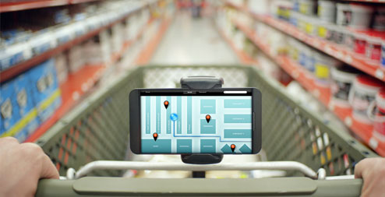
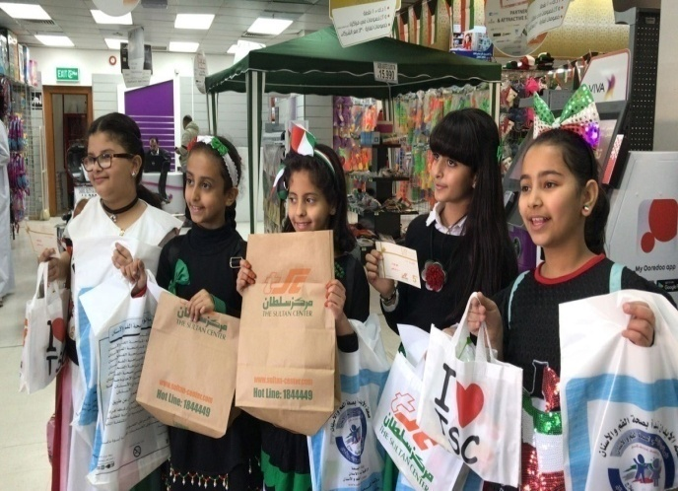
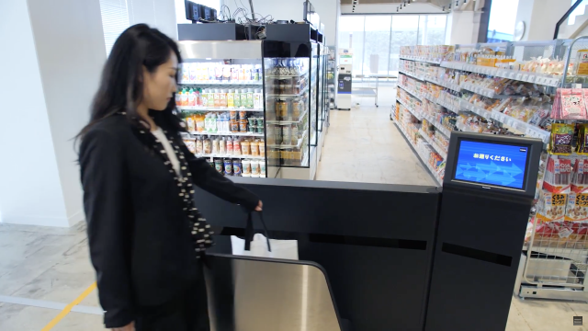

Slide 2

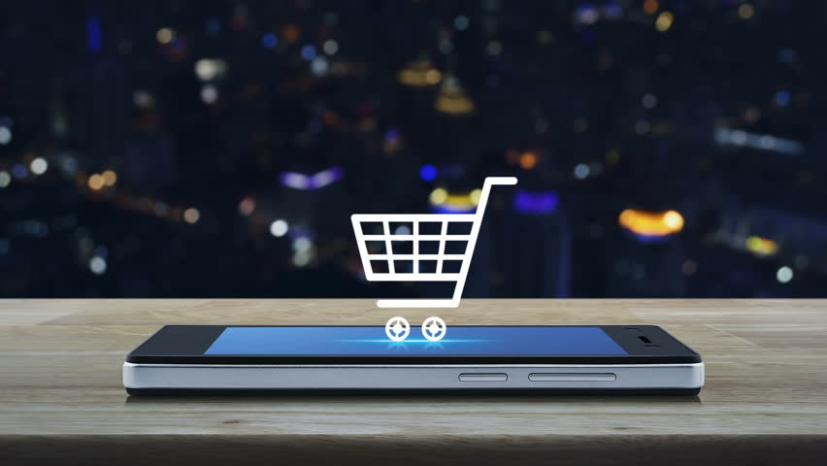

Security & Surveillance
“Digital India”

Slide 3
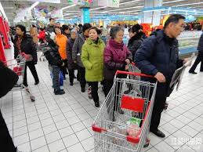
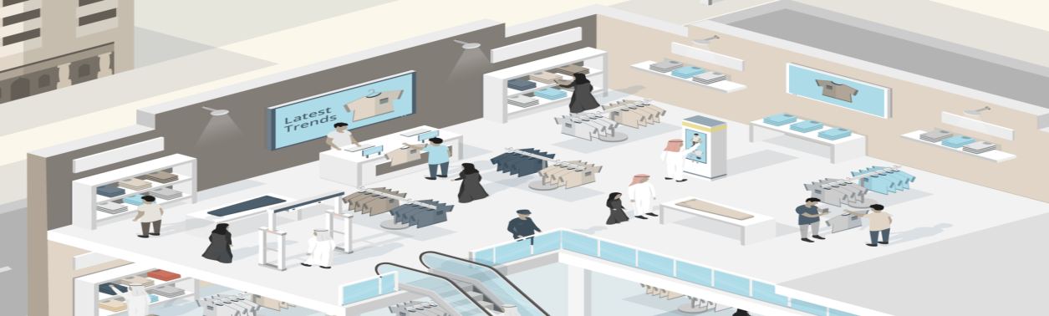
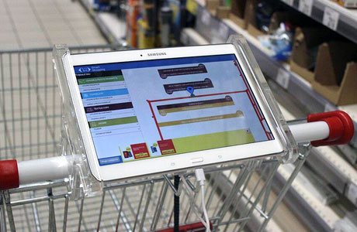
Objective: In this project we are implementing a sy “Barcode based smart trolley system ” developed for Customers person in mall while buying anything in terms of reduced time spent while purchasing. The main objective of proposed system is to provide a technology oriented, low-cast easily scalable, and rugged system for assisting shopping in person.

Slide 4


Slide 5
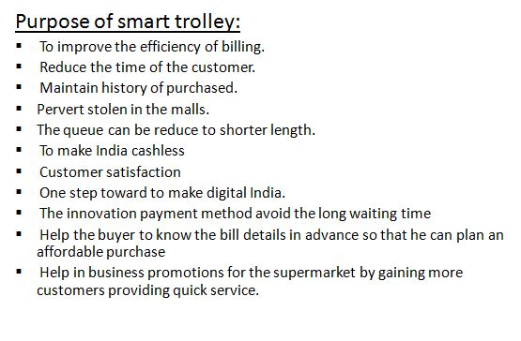
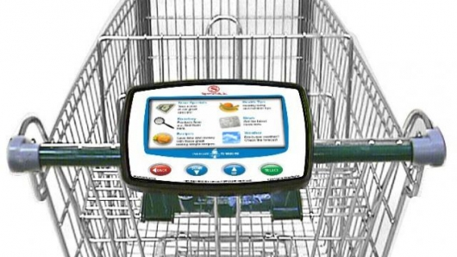
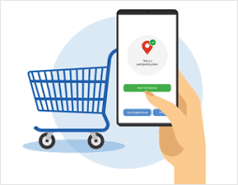
Benefits Using Smart Trolley

Slide 6
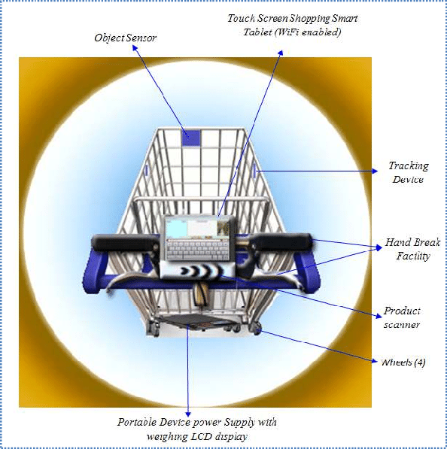
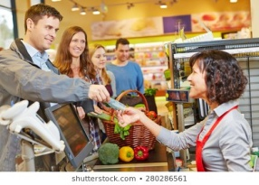
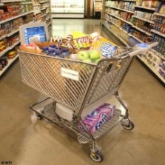
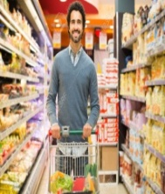
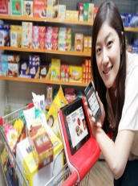
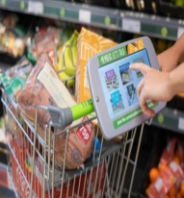
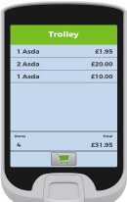
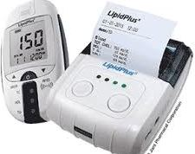

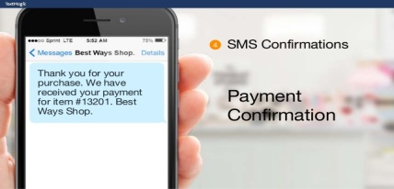
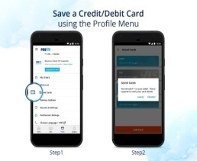
Smart trolley design analysis:
The smart trolley design consists of the following components.
Smart trolley design and user interface.
Connection to the store database.
Wireless access
Network
Scanning product
Power
Payment methods and generation of receipt.
Smart trolley design and user interface:
The smart trolley inevitably will require very good and flexible design that will attract the client to use the product.
The smart trolley should be easy to move around.
Each smart trolley should be fitted with security tracking device to stop people taking it out of the retailer’s premises.
It should be fitted with a barcode scanner and a screen a device (shopping mobile) to display all scanned product and prices with help button that can be pressed for any kind of help.
Shopping mobile should be user friendly, touch screen, easy to use, fitted to the trolley and has dynamic low power saving mode and wireless enabled.
The trolley should be designed with four wheels, a break and easy to handle or steering.
After shopping the device has the capability to send a receipt via text message.
Requires power supply for all attached devices. Cash on
Smart Trolley Using Process Diagram: delivery
Generate receipt
Use trolley Add items Add total Show
Amount
Scan
Online payment
(mobile App)

Slide 7
Smart Trolley Using Process:
comes to Super market Scan Active User
Go to find Transaction
outside Display
through User can
After
Shopping
Go to Transaction
Methodology:
Technology used:
Software: JSP, PHP, MySQL, HTML, CSS, Bootstrap-3.
Hardware: Node-MCU, RFID reader, Trolley, Barcode Reader, Raspberry pi.
Conclusion:
In Smart Trolley System, now there is no need for the customers to wait in the queue and wait for his/her turn for the scanning of the product items. Especially during weekends or festivals season, there is no time wastage in waiting in the queue. The customer has to do only payment(offline) at the billing counter or (online) payment (paytm,googlepay,phonepay,etc) and only those customers can use the smart trolley who are having membership RFID card and smart trolley apps. So, supermarkets use this Smart trolley as their business strategy to attract more number of customers.
Start
USER
Take smart trolley
Trolley barcode with mob Apps
Trolley & Apps
Takes product ,scan & put in trolley
Massage in mobile
Online
User wants pay
Add or Remove products
Product details in mob Apps
RFID scanner
Billing Counter
& takes bill
Offline

